Slide 1
Group 10
Isa van der Mierde, Max Meiners, Marwa Rouah, Michal Dziechciarz

Slide 2
Table of Contents
Theme
AI canvas
EDA

Slide 3
Public Nuisance
What are the most important factors that the municipality of Breda needs to take into account to effectively allocate resources in order to prevent public nuisance?
Can the development of an algorithm aid in predicting the risk of public nuisance in specific areas within the municipality?
Why?
Allocating resources effectively.
Proactive measures instead of reactive responses.
Valuable research question for individuals and organizations.
Pre-emptive actions for maintaining order and harmony.
Problem:
Maintaining appeal for a diverse population.
Challenges in defining and assessing public nuisance's impact on quality of life.
Attracting new residents.
Crucial challenge: Accurately identifying factors that contribute to public nuisance.

Slide 4
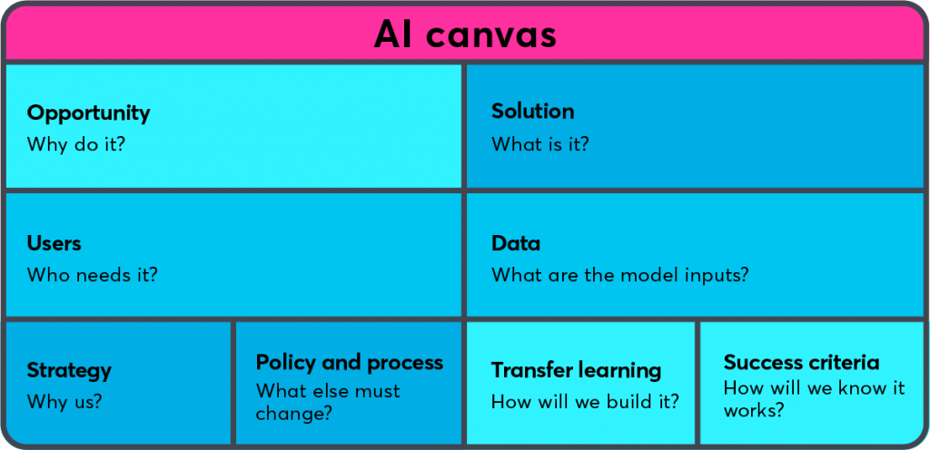
AI Canvas: Help explore solutions & ideas
Resource optimization, early intervention, data-driven decision-making and continuous improvement
Data collection, model development, predictive analysis, resource allocation
Data.politie.nl
Opendata.cbs.nl
Municipality of Breda
Predictive model
SKIP THIS PART
Policy alignment and legal and ethical considerations
precision, recall, and F1 score

Slide 5
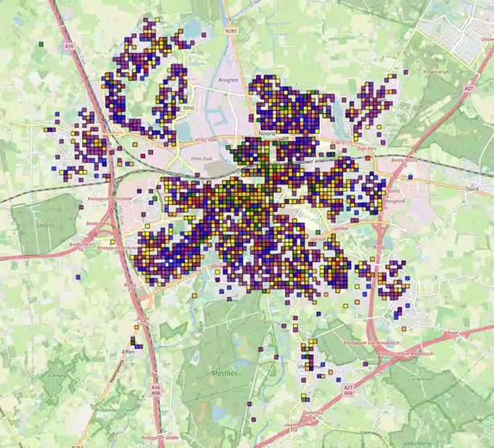
EDA Results
Afval: blue
Zwervers: green
Drugs/alcohol: red
Jeugd: orange
Parkeeroverlast: purple
Fietsoverlast: yellow
Wildplassen: grey

Slide 6
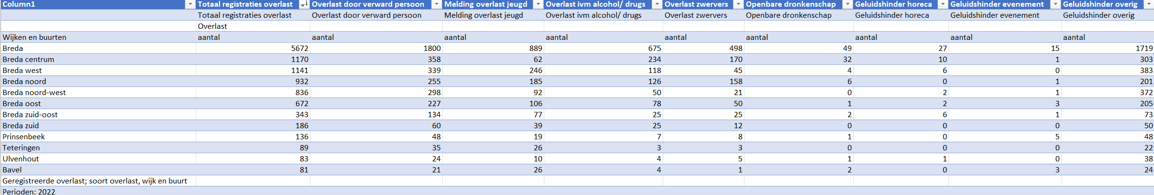
EDA Results

Slide 7
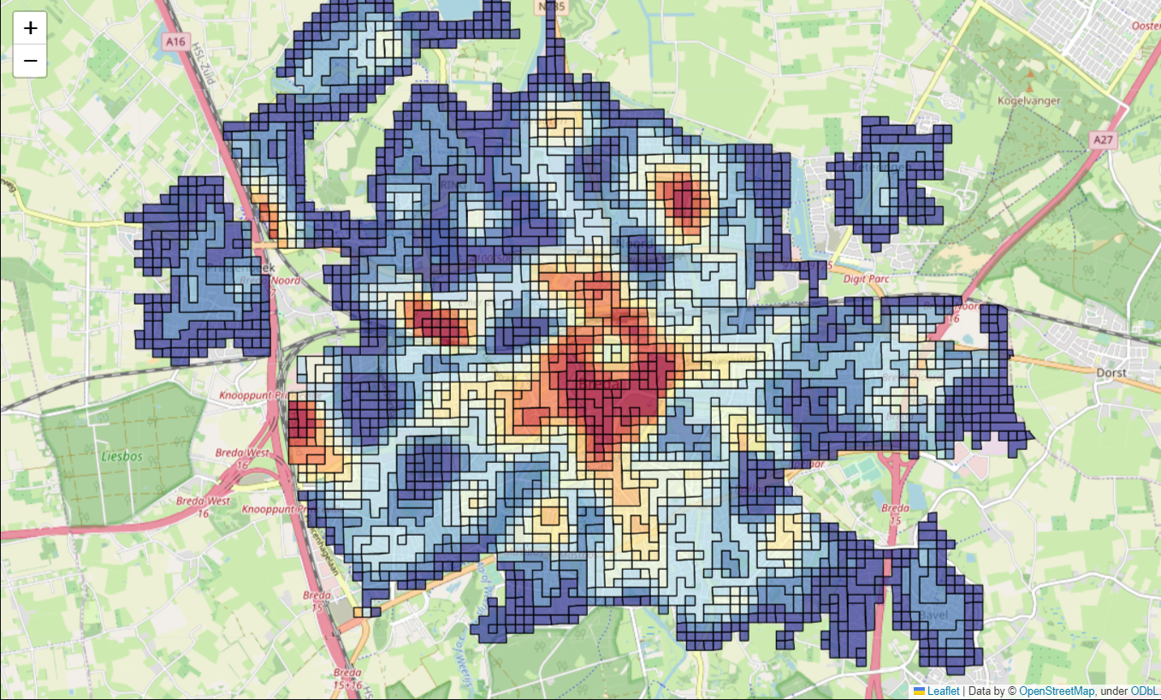
EDA Results
Visualization of neighbourhoods with highest heat indices in Breda

Slide 8
Questions?

